Slide 1
VA – Lab Project Dow Jones Industrial 30
Rudi Gruber, Martin Ennemoser

Slide 2
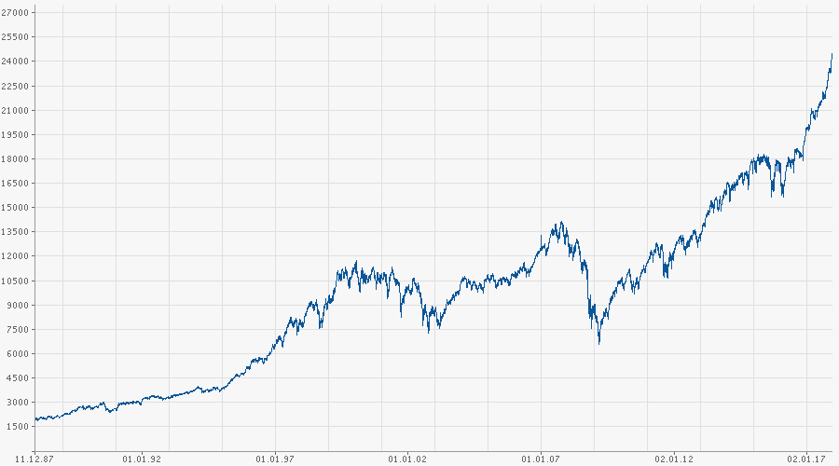
Dow Jones Industrial
Named after Wall Street Founders
Charles Dow
Eduard Jones
Established since 3rd July 1884
Measurement of US Stock Market
Performance Index
30 biggest US Companies
Apple
Goldman Sachs
General Electric
Coca Cola
Nike
Traded at the NYSE
Time Series
1997 – 2017
Source: Thomson Reuters Eikon

Slide 3
What to Visualize?
Line Charts (log Scale)
Trendlines (Simple Moving Averages)
Beta Factors (Risk Measure)
Visual Notifications on Buy/Sell Signals
(Sector) Performance Comparisons
Trading Patterns (Volume, Seasonal Patterns)
Visualisations of Profit Distribution (Histogramm, Violin Plots)
Cluster Analysis
Correlation Matrix for Profit
Etc.

